Slide 1
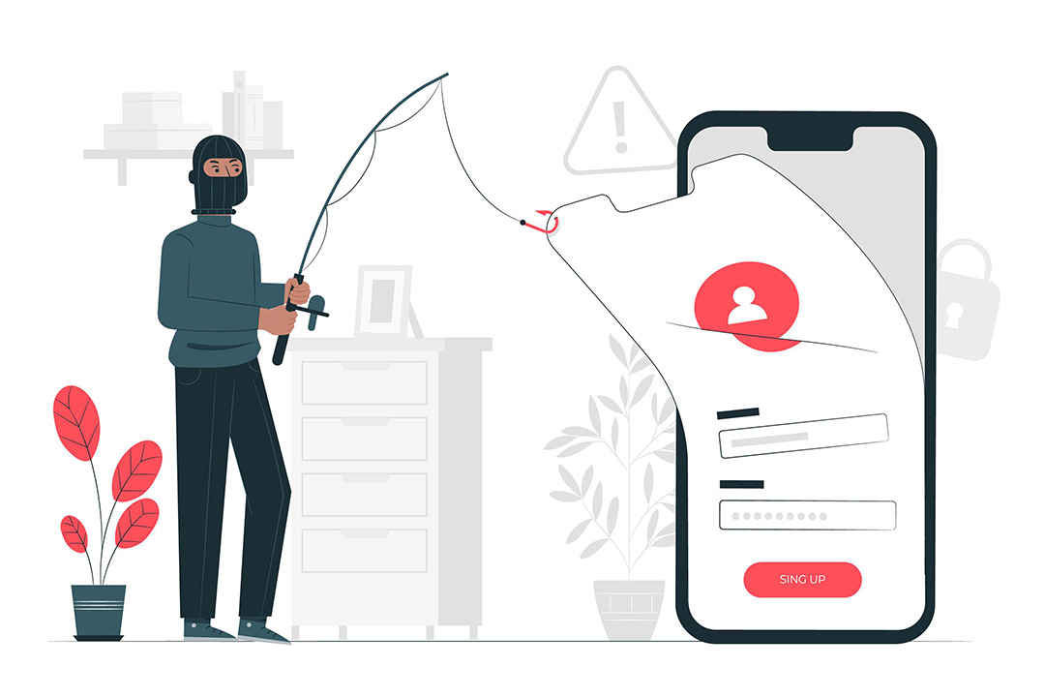
Introduction (Task 2) Phishing Awareness Training
We’re going to talk about phishing attacks. Phishing is a type of cyber attack where scammers try to trick you into giving them your personal or financial information.
Presentation Done By: Lingelihle Nyuswa

Slide 2
What is Phishing?
Fake emails that look like they're from a trusted source
Scammers posing as government officials or law enforcement
Spams and junk emails asking for personal or financial information

Slide 3

How Phishing Works
Spoofed emails and websites that look like they are from a trusted source
Urgency and fear-mongering to create a sense of panic
Preying on human psychology and emotions to trick victims

Slide 4
Types of Phishing Attacks
Email phishing: Scammers send fake emails that appear to be from a legitimate source
SMS phishing (Smishing): Scammers send fake text messages that appear to be from a legitimate source
Vishing: Scammers make fake phone calls that appear to be from a legitimate source
Whaling: Targeted phishing attacks on high-level executives or celebrities

Slide 5
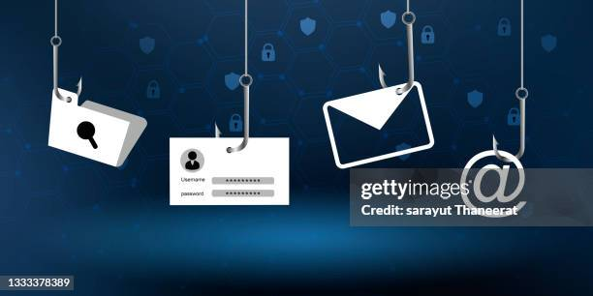
How to Recognize Phishing Attacks
Suspicious URLs or email addresses
Urgent language or threats
Misspelled words or poor grammar
Unusual attachments or links

Slide 6

How to Avoid Phishing Attacks
Be cautious when clicking on links or downloading attachments
Verify the authenticity of emails and websites
Use strong passwords and keep them confidential
Keep your software and operating systems up to date

Slide 7
What to Do If You're Phished
Don't respond or click on any links or attachments
Report the incident to your IT department or organization's security team
Change your passwords immediately

Slide 8

Social Engineering Tactics
Pretexting: Scammers pose as someone you trust to gather information
Baiting: Scammers leave malware-infected devices in public places for unsuspecting victims to find
Quid pro quo: Scammers offer something in exchange for sensitive information

Slide 9
Protecting Yourself Online
Use antivirus software and keep it up to date
Use a reputable internet security suite
Be cautious when using public Wi-Fi networks
Use strong passwords and keep them confidential

Slide 10
Conclusion
Remember, phishing attacks are common, but you can protect yourself by being aware of the tactics used by scammers and taking steps to stay safe online. Stay vigilant and stay safe!

